Slide 1
Introduction to nlp
Natural language processing
Gene Olafsen

Slide 2
NLP unleashed
Translation
Summarization
Parsing
Sentiment Analysis

Slide 3
Authoritative Sources
https://www.tensorflow.org/tutorials/word2vec
https://www.tensorflow.org/tutorials/seq2seq
Much of the content for this slide deck is derived from:
Hands-On Machine Learning with Scikit-Learn & TensorFlow, Aurelien Geron, O'Reilly Publishing

Slide 4
Word encoding
One-hot Vector
10,000 word vocabulary represented as an incredibly sparse 10,000 dimensional vector
Embedding
Operates in a small and dense vector
The neural network training phase allows the model to 'learn' the embedding position of words in a vector.
Backpropagation moves the word embeddings around.
"Similar" words typically cluster close to each other.

Slide 5
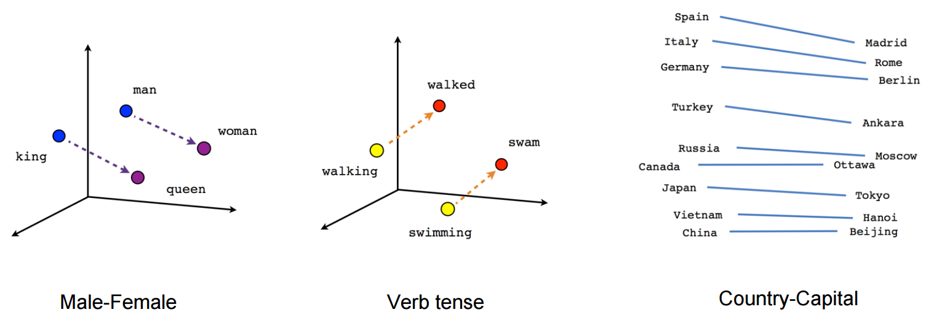
Word relationships
Source: https://www.tensorflow.org/tutorials/word2vec

Slide 6
input phrase and scrubbing
"I drink milk" is the phrase to be fed into the neural network.
Scrub the input
Replace unknown words with a predefined token: [UNK]
Replace numbers with a token [NUM]
Url's with [URL]
Etc..

Slide 7
Walk through the embedding process
Create the variable representing the embeddings for every word in the vocabulary.
Perform random initialization.
Vocabulary_size = 50000
Embedding_size = 150
init_embedding = tf.random_uniform([vocabulary_size, embedding_size], -1.0, 1.0)
embeddings =tf.Variable(init_embedding)

Slide 8
Trained Embedding
It is common to reuse your trained embeddings in other NLP applications.
There are pretrained word embeddings that are available for download.
Similar to 'transfer learning' described in earlier slide decks, which froze specified layers, pretrained embedding layers can likewise be frozen.
http://ahogrammer.com/2017/01/20/the-list-of-pretrained-word-embeddings/
https://github.com/Hironsan/awesome-embedding-models
https://github.com/bheinzerling/bpemb

